Slide 1
School Uniform Information Guide.
Etonbury Academy
Scan the QR Code to find the school page!
For delivery before Back to School, please order by:
Wednesday 13th August 2025

Slide 2
Dear Parents & Carers…
We always encourage parents to order as soon as possible to ensure you will have the correct uniform for Back to School. You will see the QR Code to order your school uniform on the front page of this booklet. Our delivery times during our “peak season” are 10 working days however, these can be longer as we move closer to Back to School.
Our shop in Peterborough is open Monday to Friday 9am till 5pm. (during the summer holidays we open on Saturdays 10-4pm)
We are here to help you if you have any questions, please call our Schools Team on 01733 394758, contact us via live chat on our website or email customerservices@totalclothing.co.uk who will be happy to advise you.
Kind Regards
Abi, Christine, Janet, Mollie, Carol, Babs and Ryan
The School Teams, Total Clothing (part of F.R. Monkhouse Ltd)
Buying school uniform can be a tricky task, so here at Total Clothing we have created our School Uniform Information Guide to help you make the process easy for you.
Inside you will find:
Hints and tips on measuring to help you get the right fit first time.
How to place your school uniform order on-line – ensure you place by Wednesday 13th August to receive in time for Back to School.
Ways to get in touch with our Schools Team.
Our Top Uniform Tips.
Our shop location in Peterborough.

Slide 3
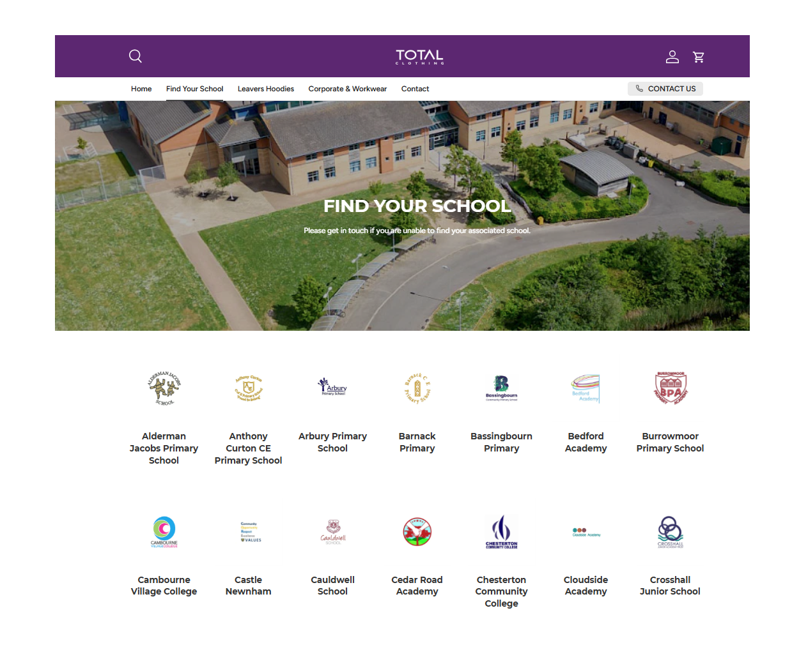
How to purchase your uniform…
How to purchase your uniform…
Click on the link in this guide or go to TotalClothing and find your school.
Click & collect from our shop or have your uniform delivered to your home.
Phone
Please call
01733 394758
Phone
Please call
01733 394758
Live Chat
Please visit our website TotalClothing
Email
Please email directly customerservices@
totalclothing.co.uk
Returns policy:
We have a returns policy of 28 days from your purchase to return or exchange your garments. It would be great if you could send your returns as soon as possible to help our stock levels.
Returns policy:
We have a returns policy of 28 days from your purchase to return or exchange your garments. It would be great if you could send your returns as soon as possible to help our stock levels.
Where to purchase!

Slide 4
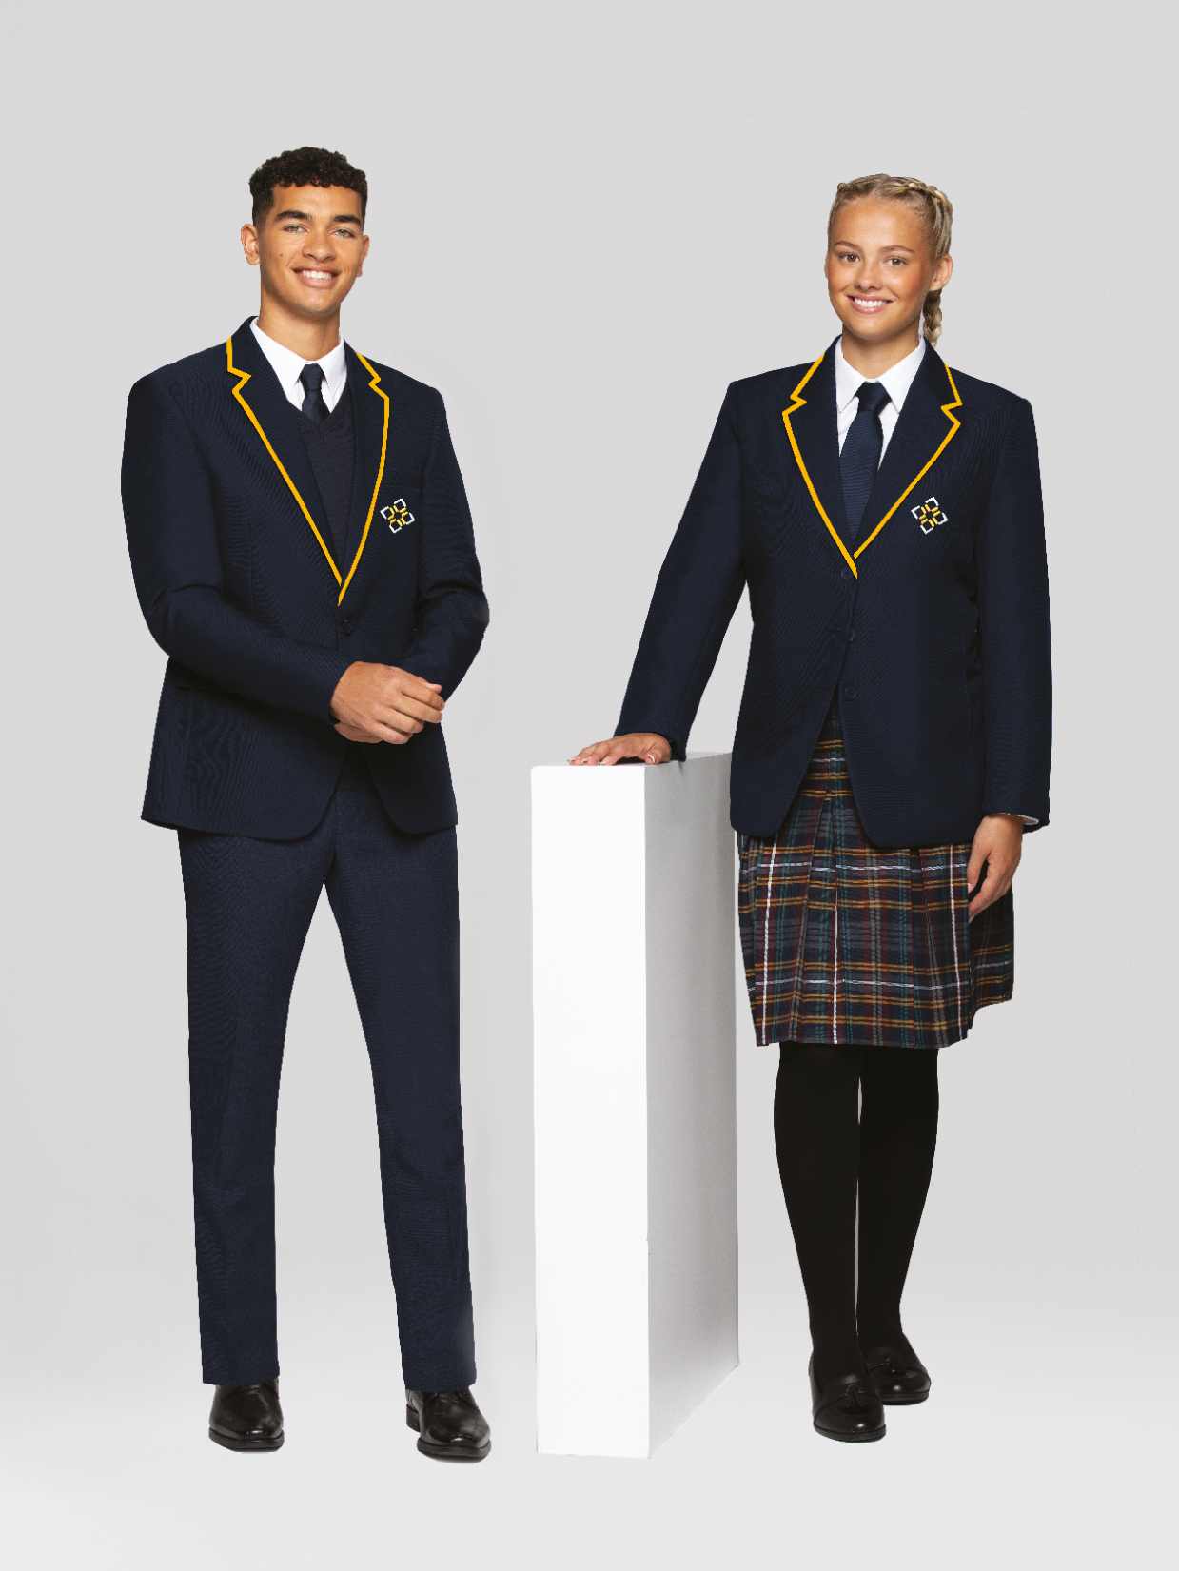
How to measure your child for school uniform…
Collar
Chest:
Place the tape measure under the arms and measure the chest at the fullest part.
Chest
Collar:
Measure around the base of the neck where the collar sits.
Waist
Hips:
Measure around the bottom, at the fullest part.
Inside Leg:
Measure from the crotch to the top of the shoe.
Inside Leg
Hips
Waist:
Measure around the natural waistline – where you would normally wear your trousers or skirt.

Slide 5
Uniform Guidelines
Years 7 and Above
Option 1 (Traditional Shirt & Tie)
Etonbury blazer
Etonbury jumper (optional)
White button-neck shirt (long or short sleeves)
Etonbury tie
Grey trousers or tailored grey shorts (Summer term)
Plain black or navy socks
Black leather shoes (no logos)
Option 2 (Blouse & Skirt)
Etonbury blazer
Etonbury jumper (optional)
White open-neck blouse
Etonbury skirt or grey trousers
Navy knee-high socks or tights (white ankle socks optional in Summer)
Black leather shoes (no logos)
Years 5 & 6
Option 1 (Shirt & Tie)
Etonbury jumper (with badge)
White button-neck shirt (long or short sleeves)
Etonbury tie
Grey trousers or tailored grey shorts (Summer term)
Plain black or navy socks
Black leather shoes (no logos)
Option 2 (Blouse & Skirt)
Etonbury jumper (with badge)
White open-neck blouse
Grey trousers or skirt
Navy knee-high socks or tights (white ankle socks optional in Summer)
Black leather shoes (no logos)

Slide 6
PE Kit Guidelines
Compulsory PE Kit (All Students)
Etonbury polo shirt (black/sky/white)
Plain black shorts or skort (black/sky/white)
Knee-high black socks
Trainers
Moulded football boots (no astro turf boots)
Gum shield
Shin pads
Optional PE Kit
Reversible sports top (black/sky)
Etonbury ¼ zip top
Black tracksuit bottoms
Black leggings with Etonbury logo (girls’ option)
Baselayer (any colour)
Note: No non-Etonbury branded shorts, joggers, leggings, or sweatshirts are allowed. Refer to the official PE expectations document.
Additional Appearance Guidelines:
Jewellery:
Only one ring, two pairs of small studs or sleepers, and a watch allowed. Must be removed for PE.
No nose studs or piercings (clear retainers only).
Hair: Natural colours only. No shaved patterns, bright highlights, or dip-dyed styles.
Make-up: Must be minimal and discreet. Light foundation/concealer, small amount of mascara or lip gloss only. No eyeliner or bold lipstick.
Footwear: No trainers, logos, boots (e.g., Dr Martens), canvas shoes, or heels.
Clothing: No denim, leggings (except Etonbury-branded for PE), cropped trousers, or short skirts. Skirts must be knee-length.
Other: Only school-approved badges allowed. Hoodies are not permitted on-site unless for official school events.

Slide 7
Our top uniform buying tips…
Sizing Question:
Please contact us if you have any queries with the sizing of garments.
Blazers:
Make sure there is “growing room” on the shoulders and arms. Blazers are machine washable at a low temperature.
Girls Trousers:
These fit just below the waist and are a generous fit. There is no adjustable waist.
Boys Trousers:
These fit true to size and have an adjustable waist.
Jumpers:
The v-neck knitted jumpers can come up fairly small in size. It would be advisable to order a size larger.
Remember:
Choose the sizes closest to your measurements.
Pleated Skirts:
The skirts sits just below the waistline. Fit just below the knee to allow for growth.
Don’t forget!
Don’t forget name labels, water bottles and mouth guards!

Slide 8
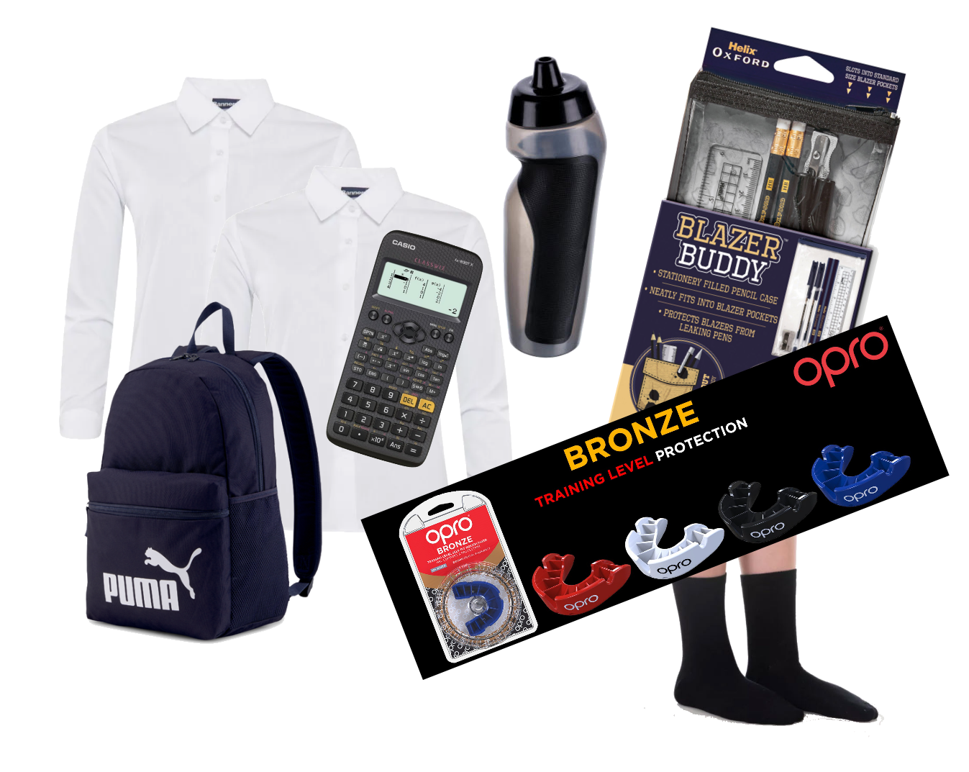
Did you know that we also sell all the Essential & Accessories you may need?
Backpacks
Helix Stationary
Calculators
Iron on Name Labels
Shirts & Blouses
Water Bottles
Gumshields
Shin Guards

Slide 9
Building a greener and fairer future…
We are committed to doing the right thing for the planet and our people, to ensure we build fairer and greener future together.
Our boys shorts and trousers are made from 65% recycled polyester and up to 11 plastic bottles are recycled to make the polyester.
Our sweatshirts and cardigans are made from 55% recycled polyester and up to 11 plastic bottles are recycled to make the polyester.
We are doing our very best to ensure all packaging is sustainably sourced by 2025. By Back to School 2025 we could have saved 50 million+ bottles from landfill.
Total Clothing – Share – Reuse - Recycle
As part of our recycling programme, we partnership with schools overseas and the UK to ensure that no garments enter landfill.

Slide 10
Sustainable development goals…
Supporting the UN SDGs
The 17 UN Sustainable Development Goals (SDGs) were created to be a blueprint to achieve a better and more sustainable future for all. We identified 13 SDGs that are central to our SER (Social Environmental Responsibility strategy). They help us focus where we can make the biggest difference and strengthen our commitment to positive social and environmental impact.
Banner’s strengthened Supplier Code of Conduct and regular auditing ensures workers in our global and UK supply chains are paid correctly by their employers.
No workers are paid less than the minimum wage.
Financial support training is made available to all colleagues.
All workers in our supply chain and across the group have access to clean drinking water and sanitation.
Our 2023 offset plans included supporting a Gold Standard carbon offset project (GM24024) for Cleaner, Safer Water in Cambodia.
We commit to an annual carbon reduction plan and made a commitment to Net Zero.
We annually measure our full Scope 3 Carbon Footprint and we offset 100% of the footprint.
Implemented a systematic waste reduction and improved waste management focus.
Regular donations to local foodbanks in Trowbridge and Altrincham helps support local families in need.
No workers are paid less than minimum wage in supplier factories.
As a group we have committed to 100% green/renewable energy procurement and achieved 100% for Banner sites and 88% for retail sites.
We implemented a 100% hybrid/EV fleet policy in 2020, 75% of our fleet are hybrid/EV.
We are exploring Solar PV options for our Trowbridge HQ sites.
Removing single-use plastic from our supply chain and moving to 100% recycled content.
Re-using plastic reclaimed from the ocean (PET).
An internal WE CARE programme providing free health and well-being 24/7 support service is available for all colleagues.
An internal team of Mental Health First Aiders are available to provide increased level of well-being support for all colleagues during these challenging times.
We are a financially stable and growing business.
All group colleagues are treated fairly and are provided with a good working environment.
Our people are given opportunities to grow and develop in their role.
There were 38 lateral moves and promotions across the group in 2023.
Regular audits of our supply chain partners ensures that they provide decent working conditions for their workers.
Banner is committed to the protection of natural resources and will source all landbased raw materials responsibly such as sustainable cotton through Better Cotton and use recycled packaging both carton and plastic as opposed to virgin materials.
Training and development plans are available for all Banner employees.
The ‘Insight’ newsletter, Banner’s voice of schoolwear, sharing advice and best practices.
Our high-quality, durable uniforms and market-leading service, ensure that children who wear our uniforms and sportswear are ready to learn.
We use a variety of raw materials and are working with our supply chain partners to ensure these materials are sourced and produced sustainably and responsibly.
75% of our stock product range is made from sustainable materials such as recycled polyester, bio-degradable viscose, sustainable cotton.
Packaging – the transition to 100% recycled content in our plastic packaging (polybags) commenced in 2023.
92.7% of our waste was diverted from landfill and we recycled 39.2 tonnes of carton packaging.
Banner is a member of and works with several influential partners in sustainability:
Banner is a member of several trade bodies, e.g. CBI, and partners with 9 Trees CIC, and local charities whilst also being an active participant in forums and networks e.g. B Locals, Future Economy Network).
Successful partnerships with the Children’s Book Project and Magic Breakfast have a real impact on children’s lives.
Alignment with this SDG underpins all our responsible business activities.
68% of our employees and 14% of our board are female.
Gender equality is a fundamental right in our supply chain. It’s covered within the Human Rights section 2.0 of our strengthened Supplier Code of Conduct that all suppliers must adhere to.
EDI is included as mandatory training for 100% of colleagues (iHASCO online training course).
We have an Equal Opportunities and Dignity at work policy.

Slide 11
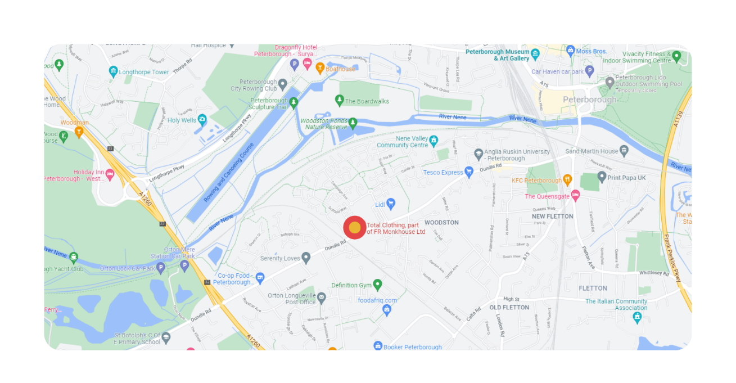
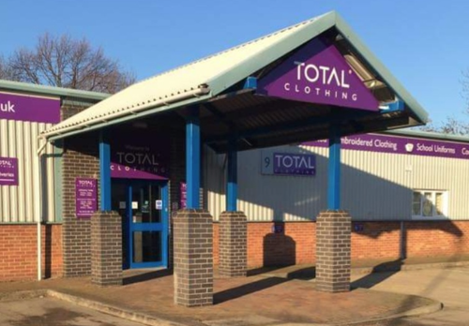
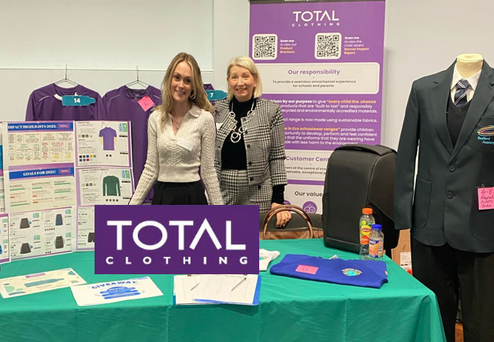
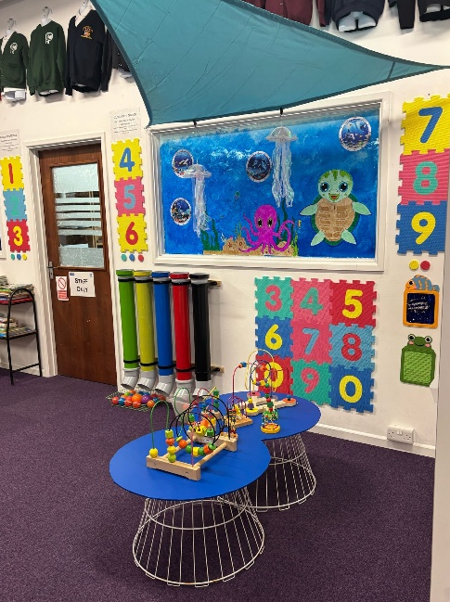
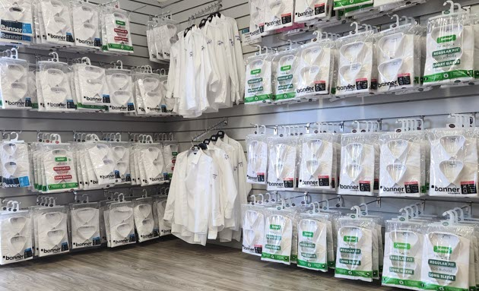
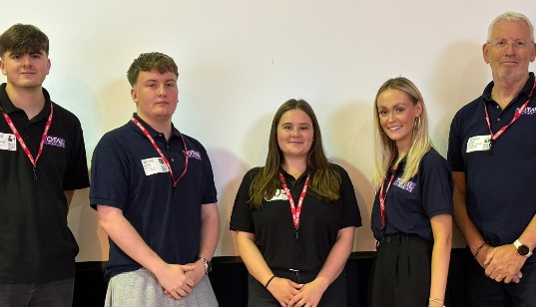
Visit us in store…
School Shop Opening Times:
Monday – Friday: 9am – 5pm
During the summer holidays we are open on a Saturday from 10am till 4pm.
Where to find us:
No.9 Botolph Trading Estate, Oundle Road, Peterborough, PE2 9QP

